Slide 1
Syntax Analysis Or Parsing
Lecture 09

Slide 2
LR(1) Item
To avoid some of invalid reductions, the states need to carry more information.
Extra information is put into a state by including a terminal symbol as a second component in an item.
A LR(1) item is:
A → α.β,a where a is the look-head of the LR(1) item
(a is a terminal or end-marker.)

Slide 3
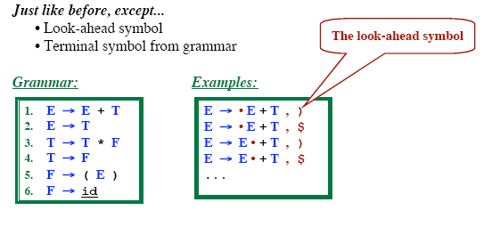
LR (1) Items

Slide 4
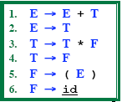
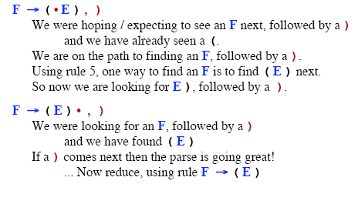
Intuition behind LR (1) Items

Slide 5
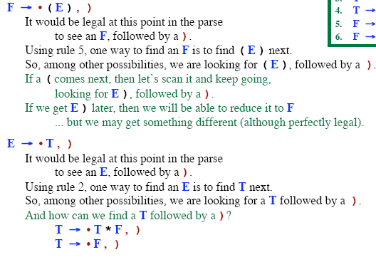
Intuition behind LR (1) Items

Slide 6
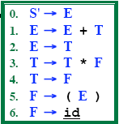
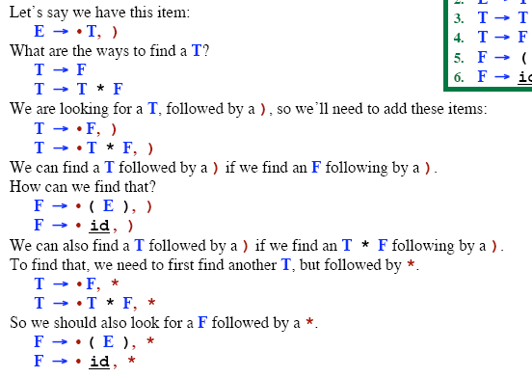
The CLOSURE Function

Slide 7
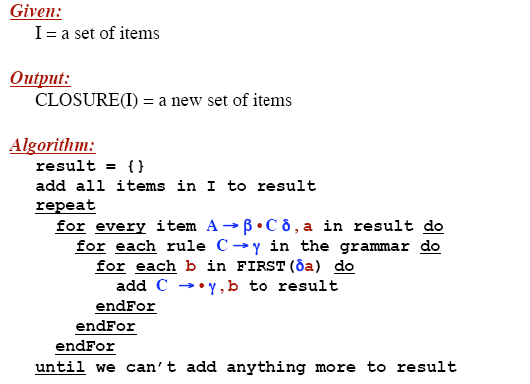
The CLOSURE Function

Slide 8
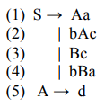
LR (1) Example
S -> CC
C -> cC
C -> d

Slide 9
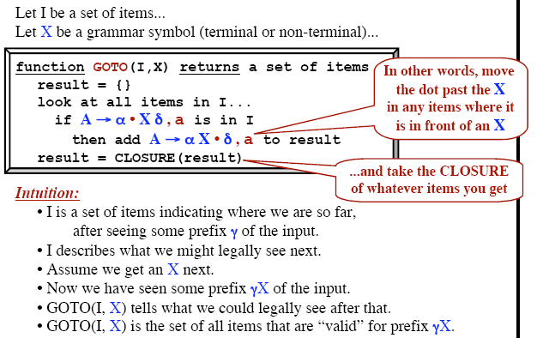
The GOTO Function

Slide 10
Construction of LR(1) Parsing Tables
Construct the canonical collection of sets of LR(1) items for G’. C←{I₀,...,I_{n}}
Create the parsing action table as follows
If a is a terminal, A→α.aβ,b in I_{i} and goto(I_{i},a)=I_{j} then action[i,a] is shift j.
If A→α.,a is in I_{i} , then action[i,a] is reduce A→α where A≠S’.
If S’→S.,$ is in I_{i} , then action[i,$] is accept.
If any conflicting actions generated by these rules, the grammar is not LR(1).
Create the parsing goto table
for all non-terminals A, if goto(I_{i},A)=I_{j} then goto[i,A]=j
All entries not defined by (2) and (3) are errors.
Initial state of the parser contains S’→.S,$

Slide 11
LALR Parsing Tables
LALR stands for LookAhead LR.
LALR parsers are often used in practice because LALR parsing tables are smaller than LR(1) parsing tables.
The number of states in SLR and LALR parsing tables for a grammar G are equal.
But LALR parsers recognize more grammars than SLR parsers.
A state of LALR parser will be again a set of LR(1) items.

Slide 12
Creating LALR Parsing Tables
Canonical LR(1) Parser
€
LALR Parser
shrink # of states
This shrink process may introduce a reduce/reduce conflict in the resulting LALR parser (so the grammar is NOT LALR)
But, this shrink process does not produce a
shift/reduce conflict.

Slide 13
The Core of A Set of LR(1) Items
The core of a set of LR(1) items is the set of its first
component.
. S → L.=R
R → L.,$
R → L.
Ex: S → L
=R,$
Core
We will find the states (sets of LR(1) items) in a canonical LR(1) parser with same cores. Then we will merge them as a single state.
I₁:L → id.,= A new state: I₁₂: L → id.,= I₂:L → id.,$
L → id.,$
Same Core
Merge Them
We will do this for all states of a canonical LR(1) parser to get the states of the LALR parser.
In fact, the number of the states of the LALR parser for a grammar will be equal to the number of states of the SLR

Slide 14
Creation of LALR Parsing Tables
Create the canonical LR(1) collection of the sets of LR(1) items for the given grammar.
Find each core; find all sets having that same core; replace those sets having same cores with a single set which is their union.
C={I₀,...,I_{n}} € C’={J₁,...,J_{m}}
where m ≤ n
Create the parsing tables (action and goto tables) same as the construction of the parsing tables of LR(1) parser.
If J=I₁ ∪ ... ∪ I_{k} since I₁,...,I_{k} have same cores
€ cores of goto(I₁,X),...,goto(I₂,X) must be same.
– So, goto(J,X)=K where K is the union of all sets of items having same cores as goto(I₁,X).
If no conflict is introduced, the grammar is LALR(1) grammar. (We may only introduce reduce/reduce conflicts; we cannot
– Note that:
introduce a shift/reduce conflict)

Slide 15
Shift/Reduce Conflict
We say that we cannot introduce a shift/reduce conflict during the shrink process for the creation of the states of a LALR parser.
Assume that we can introduce a shift/reduce conflict. In this
case, a state of LALR parser must have:
A → α.,a and B → β.aγ,b
This means that a state of the canonical LR(1) parser must have:
A → α.,a and B → β.aγ,c
But, this state has also a shift/reduce conflict. i.e. The original canonical LR(1) parser has a conflict.
(Reason for this, the shift operation does not depend on lookaheads)

Slide 16
Reduce/Reduce Conflict
But, we may introduce a reduce/reduce conflict during the shrink process for the creation of the states of a LALR parser.
I₁ : A → α.,a B → α.,b
I₂: A → α.,b B → α.,c
€ reduce/reduce conflict
⇓
I₁₂: A → α.,a/b B → α.,b/c

Slide 17
Any Questions ?

